Slide 1
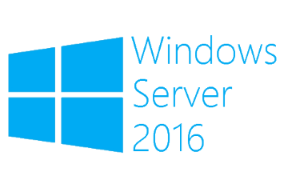
Cluster OS rolling upgrade
Megaseries

Slide 2
Introduction
New feature in Windows Server 2016
Allows the OS of cluster nodes with at least Windows Server 2012 R2 to be upgraded without downtime for some workloads and minimum downtime for others
Can be executed without additional hardware
Cluster does not need to be stopped or restarted
The upgrade is reversible
You do not need a second cluster

Slide 3
More info
The earliest version that you can upgrade from is Windows Server 2012 R2
Hyper-V clusters and Scale Out File Server clusters can be upgraded with no downtime
The process can be automated via Powershell
Not supported on guest clusters that use shared vhdx files
Newer OS nodes operate at the lower OS compatibility mode until the administrator specifies otherwise

Slide 4
Step 1
We first start with a cluster with Windows Server 2012 R2 nodes (cluster functional level 8)
Each node hosts one VM with version 5
VM
VM
VM
VM

Slide 5
Step 2
Pause one of the nodes and drain it (move all resources to other nodes of the cluster)
VM
VM
VM
VM

Slide 6
Step 3
Evict the node from the cluster and reinstall the OS (do not upgrade it but reinstall it by formatting the disk)
VM
VM
VM
VM

Slide 7
Step 4
Add the node back to the cluster
The cluster now operates in mix OS mode and nodes with both OS versions can be added to it
VM
VM
VM
VM

Slide 8
Moving forward
Repeat steps 2-4 for all other nodes
Now the cluster has only Windows Server 2016 nodes but it is still operating in mixed OS mode and it is at functional level 8 (2012 R2 nodes can still be added)
VMs are still at version 5
VM
VM
VM
VM

Slide 9
Step 5
Upgrade cluster functional level
Now the cluster is operating in Windows Server 2016 mode with all new features; 2012 R2 nodes cannot be added anymore
VMs are still version 5 (can be moved to 2012 R2 servers if needed)
VM
VM
VM
VM

Slide 10
Step 6
Upgrade VM version to 8
VMs now cannot be moved to servers with earlier OS versions than Windows Server 2016
VM
VM
VM
VM

Slide 11
Alternative way
You can also do a rolling upgrade with extra nodes
Just add all the new nodes to the cluster and then start removing the old ones
This makes the operation less risky but also requires you to have the extra hardware

Slide 12
More info
https://docs.microsoft.com/en-us/windows-server/failover-clustering/cluster-operating-system-rolling-upgrade

Slide 13

https://www.youtube.com/channel/UCcZ-jLbPwNr8E_v9-65n8Iw https://github.com/itknowledge4

